Slide 1

Bioinformatic approaches to regulatory genomics and epigenomics
376-​1347-00L | week 10
Pierre-Luc Germain

Slide 2
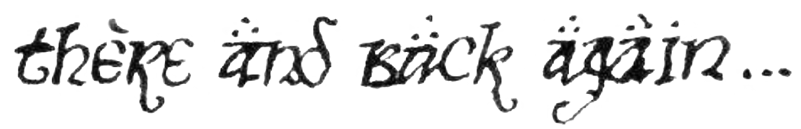
Plan for today
Theory: from repression to activation and back
Clustering on genomic signals
Region-based GO enrichment analysis

Slide 3
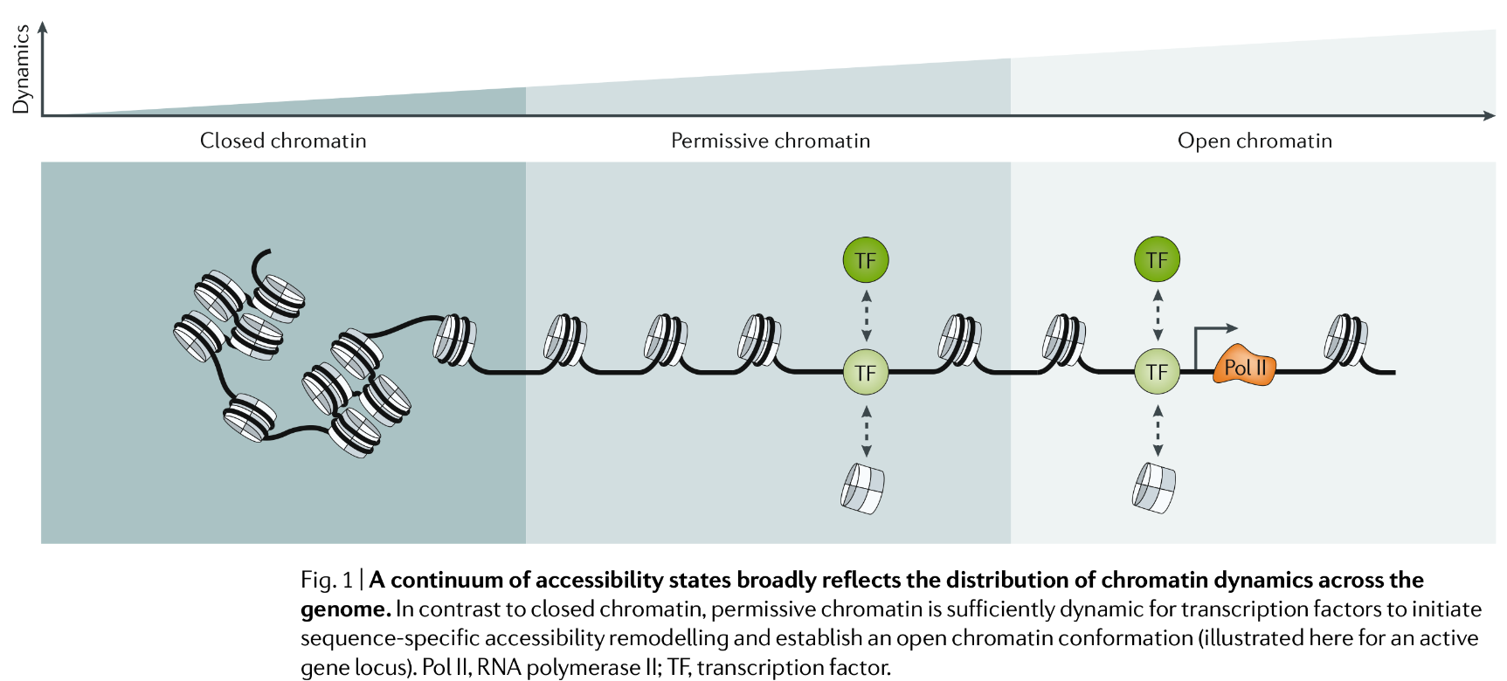
There are degrees of accessibility (activation/repression)
(Klemm, Shipony and Greenleaf, 2019)

Slide 4
There are degrees of accessibility (activation/repression)
Heterochromatin
(stable repression)
Very low accessibility
?
Poised/silenced
Low accessibility
H3K27 methylation
Active elements
Very high accessibility
RNApol2 binding
H3K4 methylation
H3K27 acetylation
HP1 binding
DNA methylation
H3K9 methylation
Fate transitions
(e.g. differentiation)
Transient responses

Slide 5
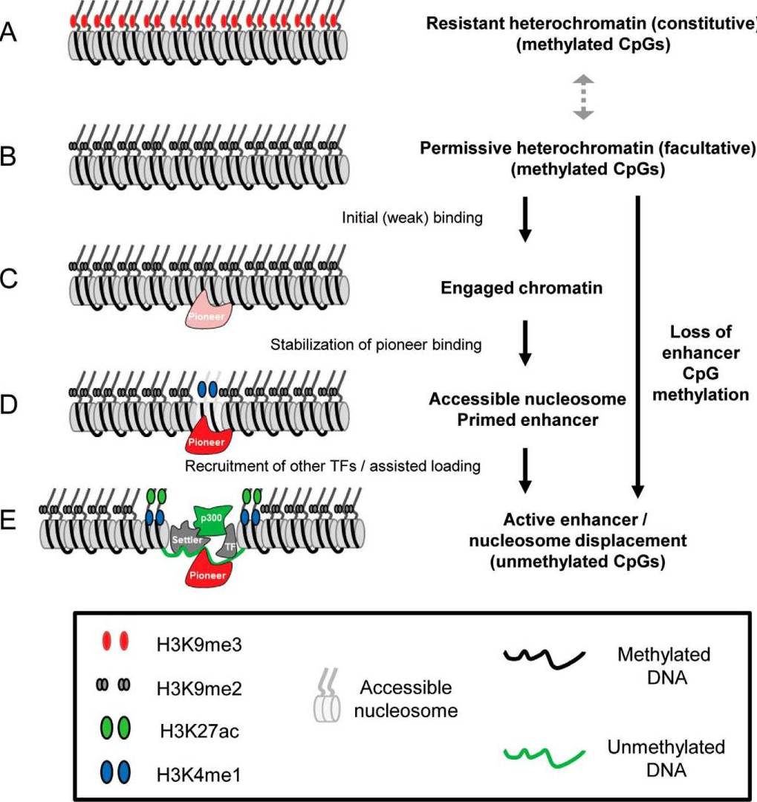
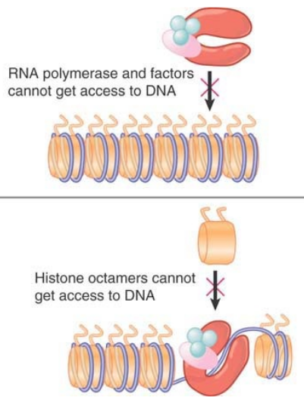
Opening chromatin
Mutually exclusive…
So how can it change?
(Adapted from Krebs, Goldstein and Kilpatrick, Genes XII, 2018)
(Mayran and Drouin, J Biol Chem 2018)

Slide 6
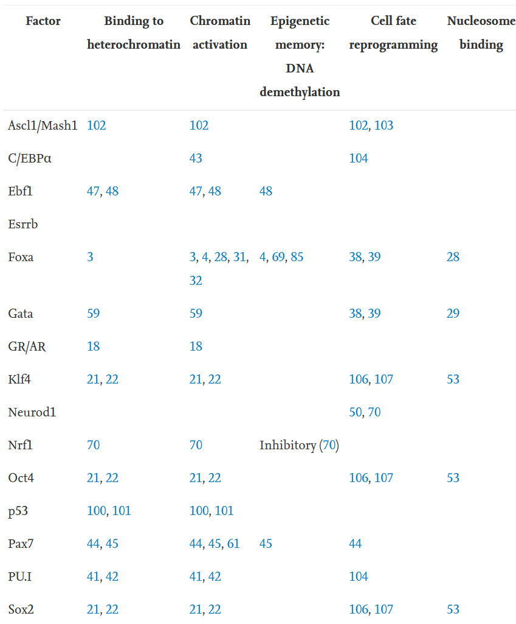
Whereas most TFs cannot bind their target DNA when it’s wrapped around nucleosomes, pioneer factors can, and can even bind in heterochromatin
Their binding is typically (but not always) independent of (and prior to) other factors
(Adapted from
Mayran and Drouin, J Biol Chem 2018)

Slide 7
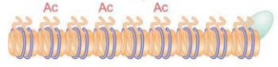
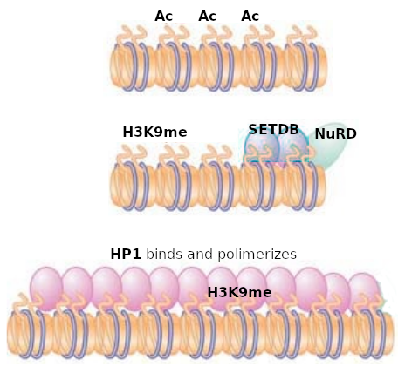
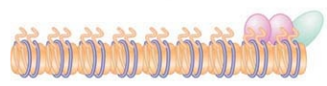
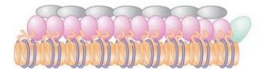
Heterochromatin formation
In yeast:
Rap1 binds to DNA
In mammals:
Sir2/3/4 bind and deacetylate histones
SIN3
Sir3/4 polymerize (and attach to the nuclear matrix)
(Adapted from Krebs, Goldstein and Kilpatrick, Genes XII, 2018)

Slide 8
Opening and closing chromatin
NuRD & de-Acetylation
Pioneer factors
Heterochromatin
(stable repression)
Very low accessibility
Poised/silenced
Low accessibility
H3K27 methylation
?
Active elements
Very high accessibility
RNApol2 binding
H3K4 methylation
H3K27 acetylation
HP1 binding
DNA methylation
H3K9 methylation
Fate transitions
(e.g. differentiation)
Transient responses

Slide 9
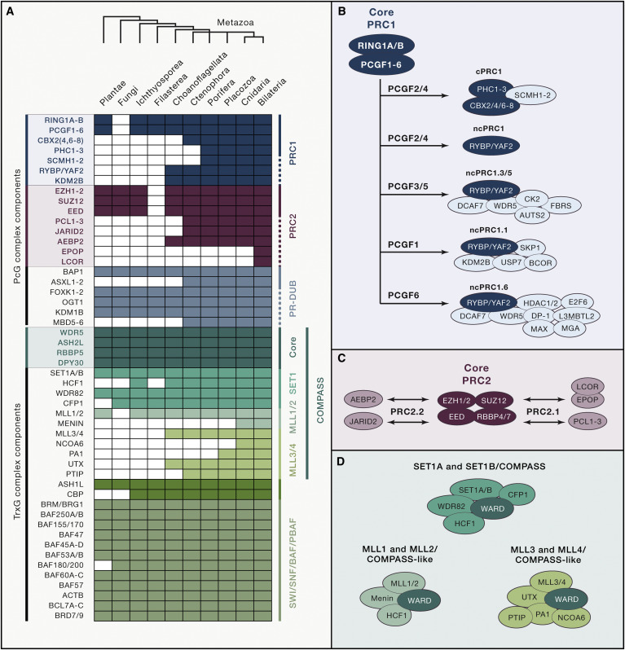
The conserved competition between Polycomb (repressive) and Trithorax (activating) protein groups regulates a very large variety of phenomena
Polycomb
(PRC1) (PRC2)
Trithorax
(Compass)
H3K27me3
(p300)
H3K27ac
H3K4me
H3K27
methylation
Stable
repression
Silenced
Bivalent
Active
H3K4
methylation
H3K27me3
+ H3K4me3/1
(aka KDM6A)
H3K27 de-methylation
(Schuettengruber et al., 2017)

Slide 10
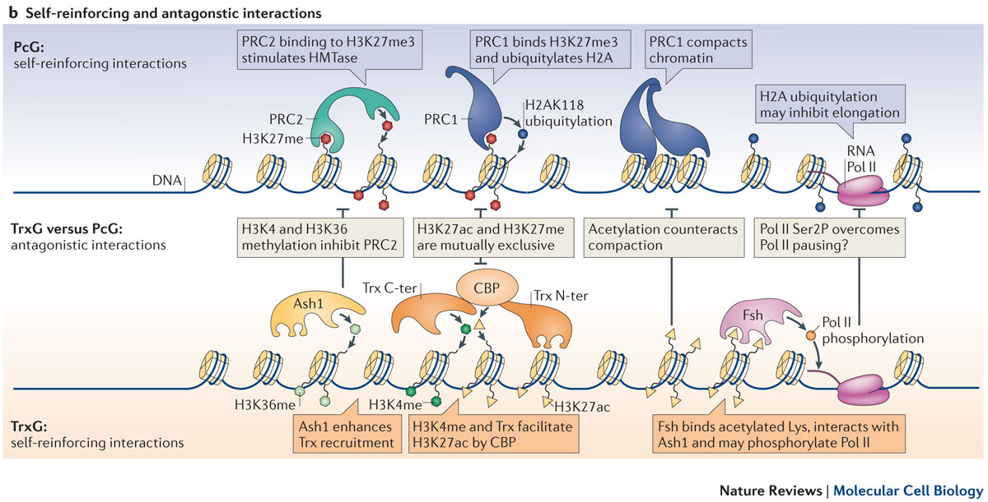
Competition between Polycomb (PcG) and Trithorax (Trx) protein groups
(Steffen and Ringrose 2014)

Slide 11
The conserved competition between Polycomb (repressive) and Trithorax (activating) protein groups regulates a very large variety of phenomena
Polycomb repressing complexes
Direct and constant competition
COMPASS
complexes
Nucleosome remodeling
complexes
Prior
(Schuettengruber et al., 2017)

Slide 12
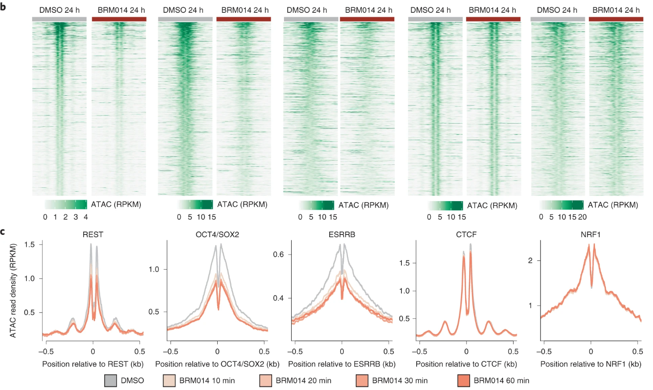
Inhibition of SWI/SNF activity instantly impairs accessibility at dependent TF-binding sites
(Adapted from Iurlaro et al., Nat Gen 2021)

Slide 13
ATP-dependent chromatin remodeling
Polycomb-repressing complexes
PRC1
PRC2
NuRD & such
Trithorax complexes
Pioneer factors
SWI/SNF/BAF complexes
COMPASS
Mediator
Heterochromatin
(stable repression)
Very low accessibility
Poised/silenced
Low accessibility
Active elements
Very high accessibility
RNApol2 binding
H3K4 methylation
H3K27 acetylation
H3K27 methylation
HP1 binding
DNA methylation
H3K9 methylation
Fate transitions
(e.g. differentiation)
Transient responses

Slide 14
Practical 1:
Clustering epigenomic signals

Slide 15
Assignment
Download and decompress the following archive:
https://ethz-ins.org/content/w10.assignment.zip
This contains the bigwig files and peaks (bed) files for three TFs of the CREB family (all restricted to chr1; aligned against the hg38 genome)
Use clustering and visualization to illustrate the relationship between the binding of the different proteins
Use enrichment analysis (either GO or motif) on at least one of the clusters
Write a paragraph describing your results
Save your assignment in a R markdown named assignment.Rmd, render it, and push the html file to this folder in your github repository

Slide 16
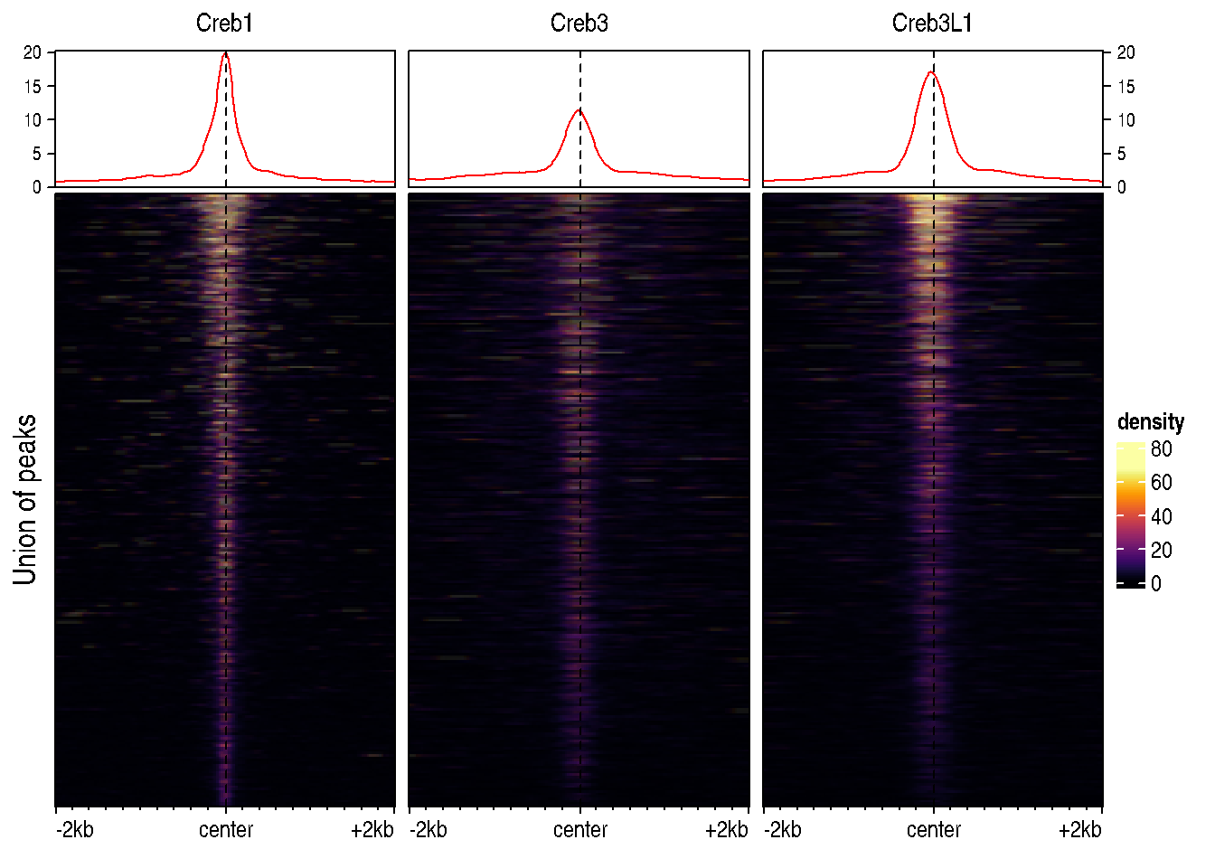
Assignment
Simply plotting the regions, the signals seem very similar… but are they?
Tip: focus on high-confidence peaks to define the universe of regions, e.g.:
peaks <- list.files(pattern="bed$")
# we first import the peaks
peaks <- lapply(peaks, rtracklayer::import.bed)
# we'll focus on the high-quality peaks
peaks <- lapply(peaks, FUN=function(x) x[x$score>800])
# we get the union of non-redundant regions
regions <- reduce(unlist(GRangesList(peaks)))

